Slide 1
Project P.E.R.F.E.C.T.I.O.N
“You can’t kill perfection”

Slide 2
Our Team
Alec - Producer (well organized and has a good overall understanding of the parts of a game, deeply sorry for this slide)
Dominick - Programmer (has a good understanding of GameMaker Studio and is not afraid to push the engine to the breaking point)
Nick - Artist (competent, owns a Cintiq, currently dead, may recover in a few days)
Spencer - Designer (organized, great idea machine, lizard Person, learning human computers)

Slide 3
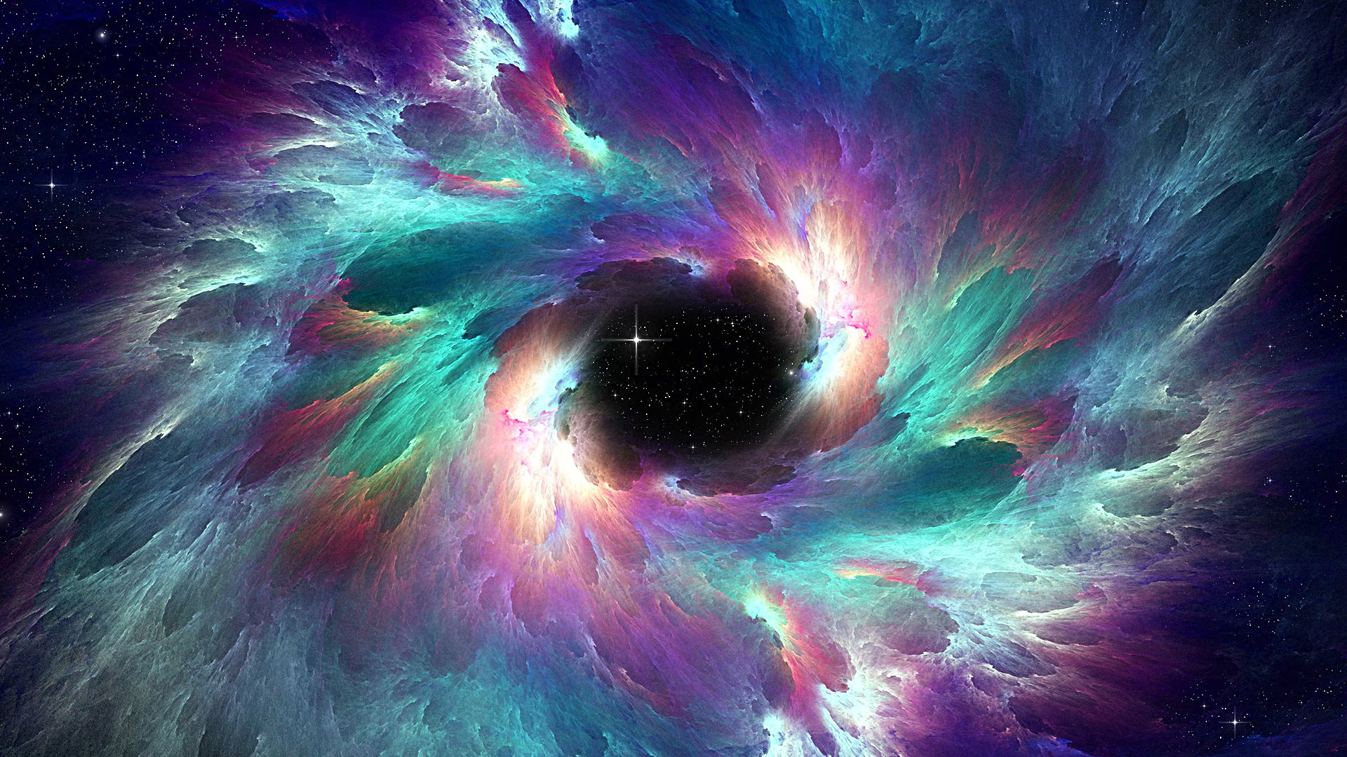
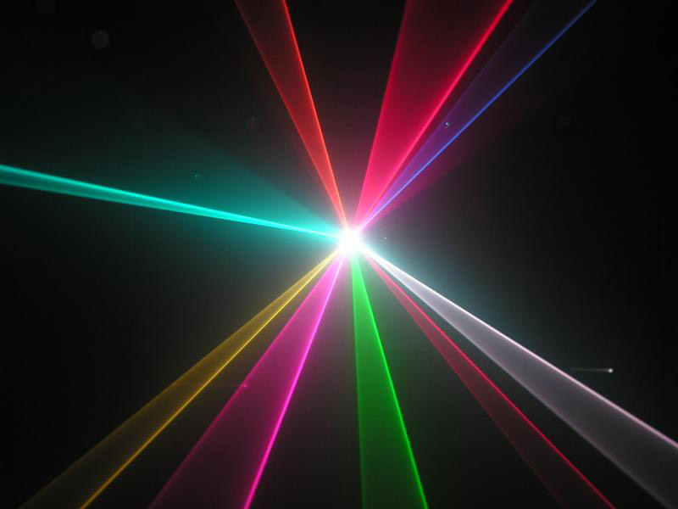
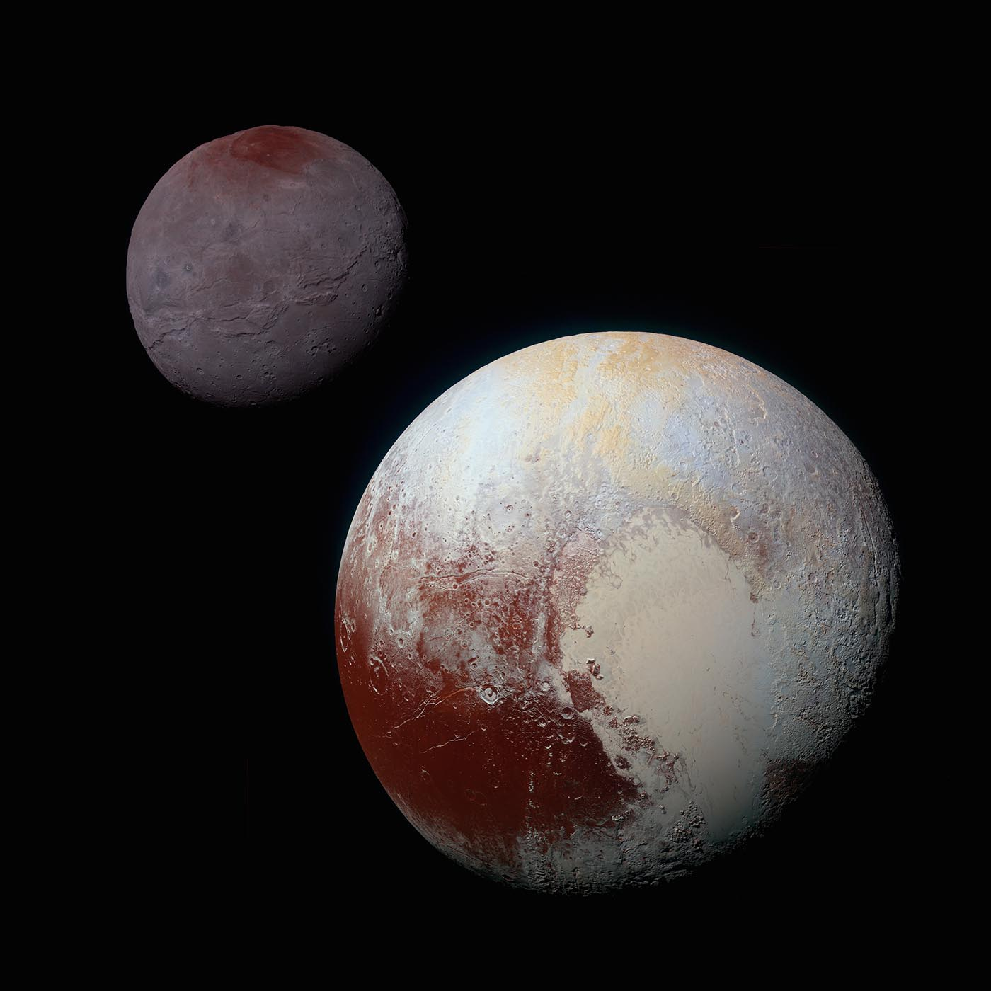
Genre
Sci-fi
Action Adventure
Looter Shooter

Slide 4
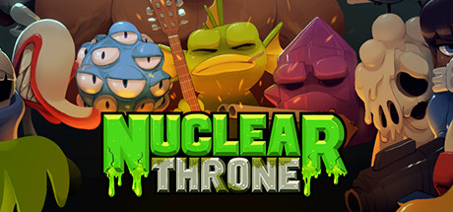
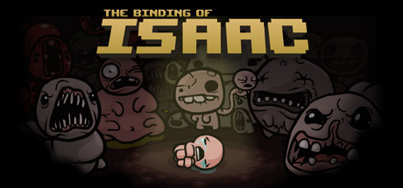

Inspiration

Slide 5
Hooks
Will have a strong artistic mood
Strong emphasis on adventuring/dungeon delving
Challenging and strategic gameplay
Death has meaningful consequences
Randomization to add variety and replay value

Slide 6
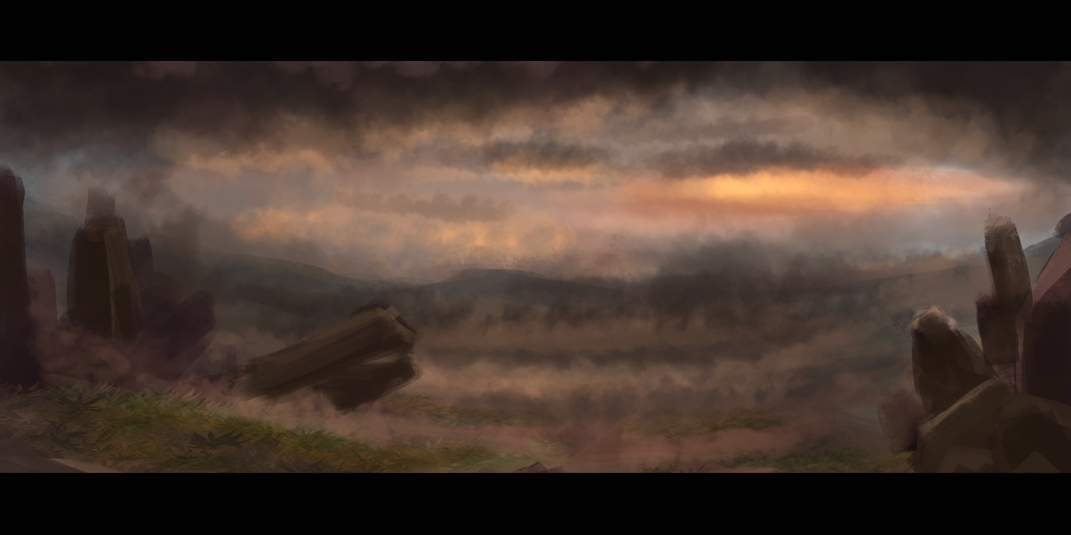
Dungeon 1: Martian Sands Theme

Slide 7
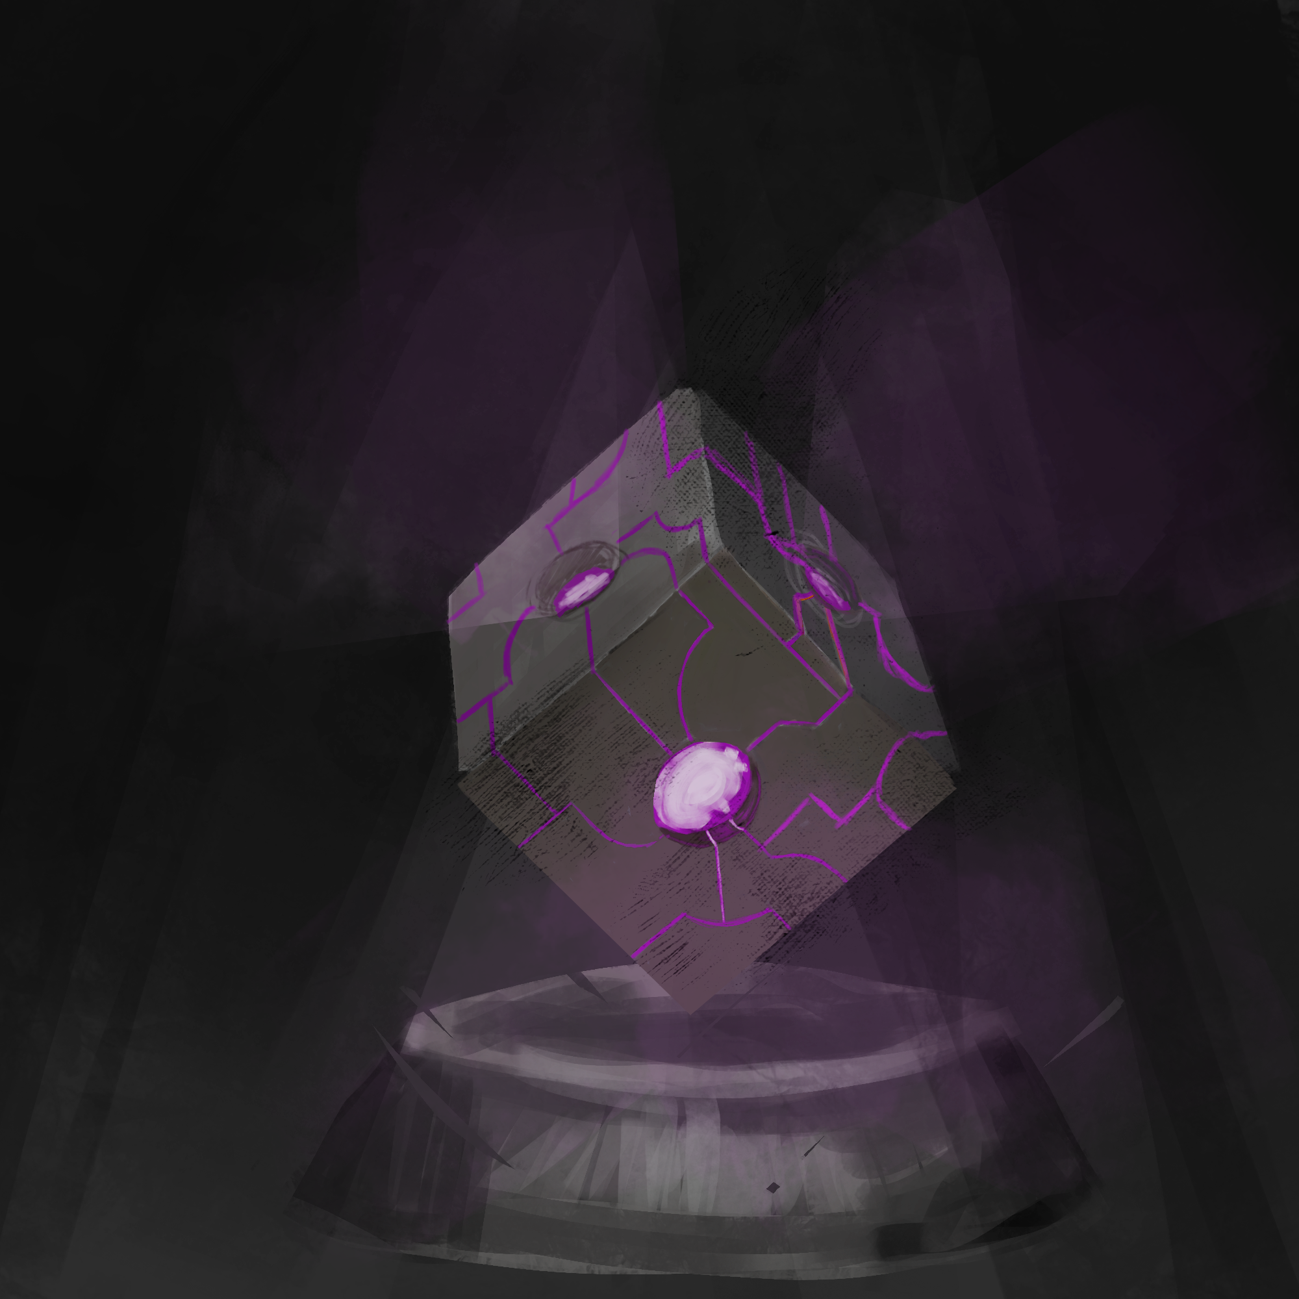
Story
The main character is sent to complete a strange cube
This involves visiting several different planets
The story arc guides the player as they complete this task
The player discovers what they are as they assemble parts of the cube

Slide 8
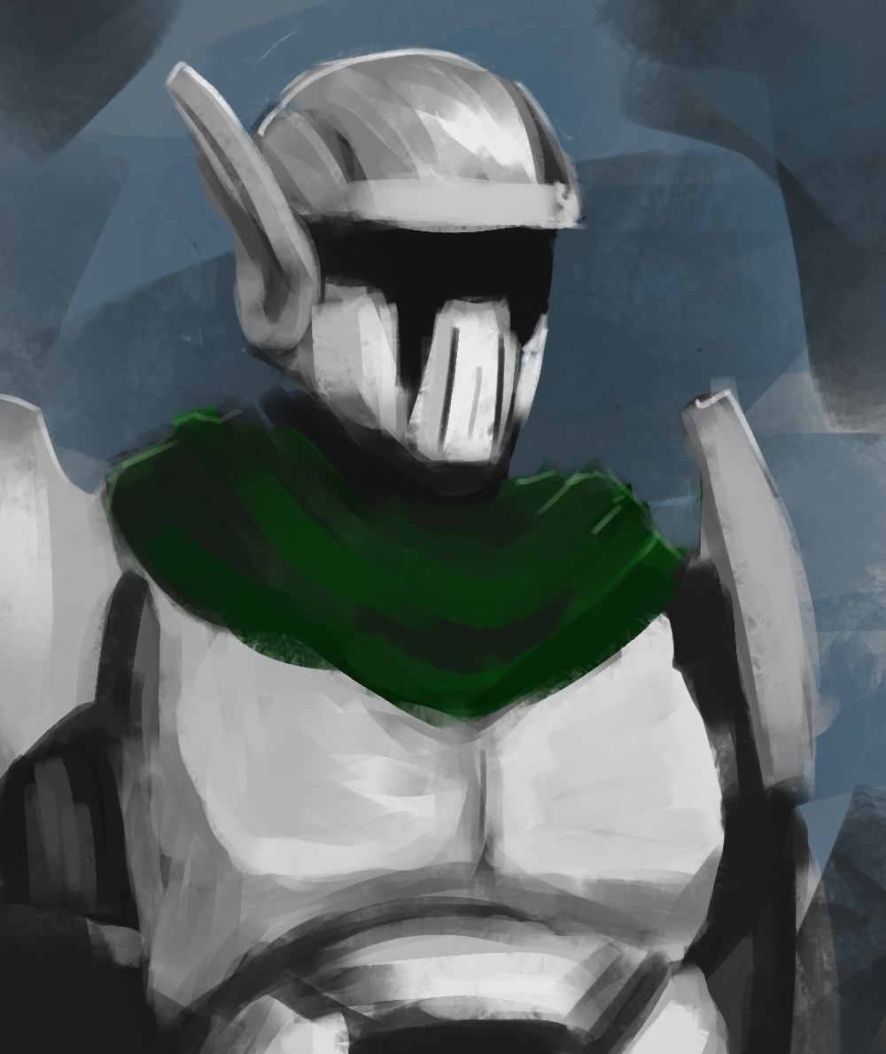
Character
Name: J
Origin: Project P.E.R.F.E.C.T.I.O.N.
Batch #: 10
Purpose: Retrieve the artifact at all costs
Status: Replaceable

Slide 9
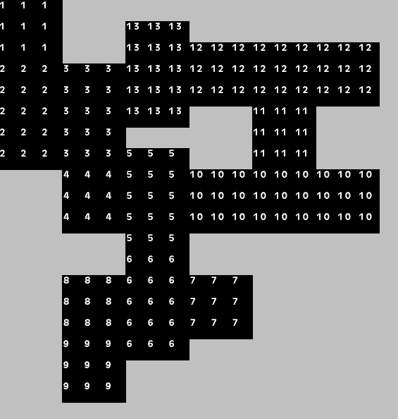
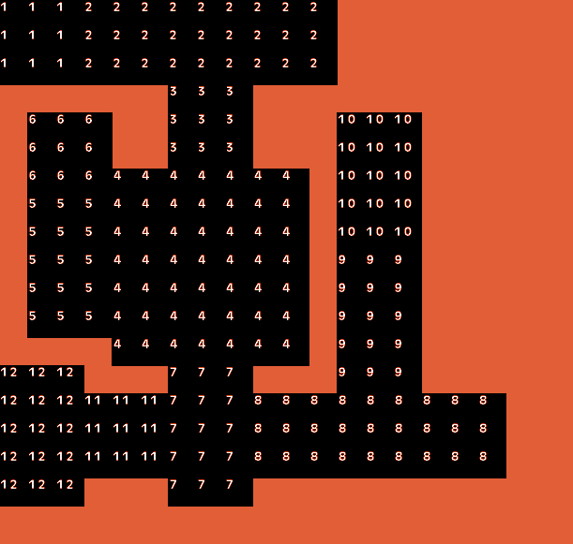
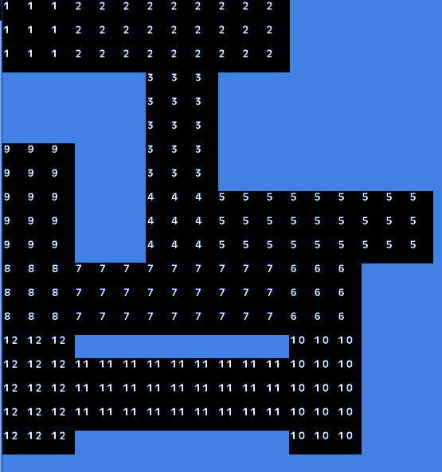
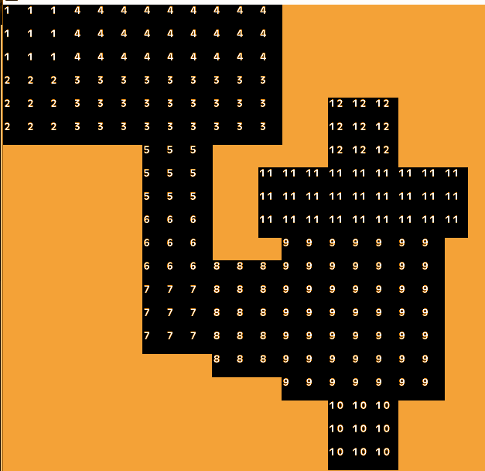
Adventuring
Most of the game is spent traversing randomly generated dungeons
Different dungeon themes per world
Each dungeon has an entrance, multiple floors, and a boss
Dungeon levels are a collection of joined rooms

Slide 10
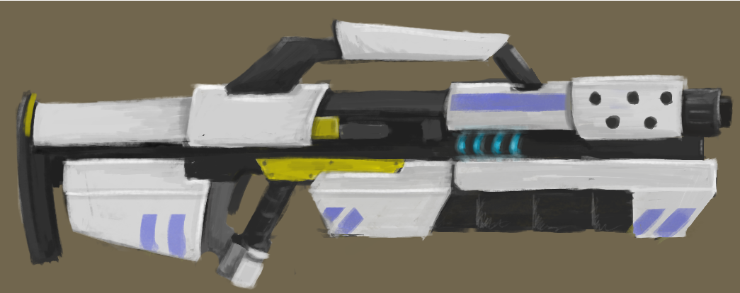
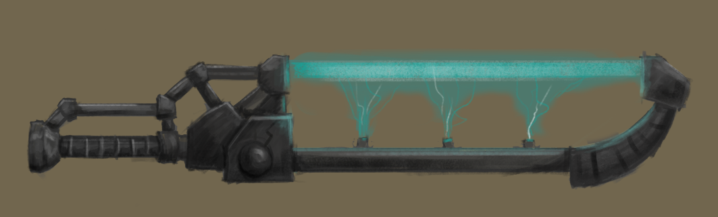
Combat
Randomized loot drops in the dungeons
Weapons equipped have a big effect on how you fight
Different types of weapons: sword, pistol, rifle
Different types of weapon modifiers: rail, scatter, explosive, plasma
Health will be a rare and important resource to manage

Slide 11
Project P.E.R.F.E.C.T.I.O.N.
Adventuring
Challenging and strategic combat
Randomized elements
Immersive mood/atmosphere

